Slide 1
Data and Computer Communications
Tenth Edition
by William Stallings
Notes:
“Data and Computer Communications”, 10/e, by William Stallings, Chapter 2 “Protocol Architecture, TCP/IP, and Internet-Based Applications”.

Slide 2
Protocol Architecture, TCP/IP, and Internet-Based Applications
Chapter 2
Notes:
This chapter provides a context for the detailed material that follows. It shows
how the concepts of Parts Two through Five fit into the broader area of computer
networks and computer communications. This chapter may be read in
its proper sequence or it may be deferred until the beginning of Part Three,
Four, or Five.1
We begin this chapter by introducing the concept of a layered protocol
architecture . We then examine the most important such architecture, the TCP/
IP protocol suite. TCP/IP is an Internet-based protocol suite and is the framework
for developing a complete range of computer communications standards.
Another well-known architecture is the Open Systems Interconnection (OSI)
reference model. OSI is a standardized architecture that is often used to
describe communications functions but that is now rarely implemented. OSI is
examined in Appendix E.

Slide 3
To destroy communication completely, there must be no rules in common between transmitter and receiver—neither of alphabet nor of syntax.
—On Human Communication,
Colin Cherry
Notes:
This quote from the start of Stallings DCC10e Ch2 illustrates a key issue which this chapter explores, providing a context for the detailed material in the following parts of the text.

Slide 4
The Need for a Protocol Architecture
To transfer data several tasks must be performed:
1.) The source must either activate the direct communications path or inform the network of the identity of the desired destination system
2.) The source system must ascertain that the destination system is prepared to receive data
3.) The file transfer application on the source system must ascertain that the file management program on the destination system is prepared to accept and store the file for this particular user
4.) A format translation function may need to be performed by one or the other system if the file formats used on the two systems are different
Notes:
When computers, terminals, and/or other data processing devices exchange data,
the procedures involved can be quite complex. Consider, for example, the transfer
of a file between two computers. There must be a data path between the two
computers, either directly or via a communication network. But more is needed.
Typical tasks to be performed:
1. The source system must either activate the direct data communication path or
inform the communication network of the identity of the desired destination
system.
2. The source system must ascertain that the destination system is prepared to
receive data.
3. The file transfer application on the source system must ascertain that the file
management program on the destination system is prepared to accept and
store the file for this particular user.
4. If the file formats used on the two systems are different, one or the other system
must perform a format translation function.

Slide 5
Functions of Protocol Architecture
Breaks logic into subtask modules which are implemented separately
Modules are arranged in a vertical stack
Each layer in the stack performs a subset of functions
Relies on next lower layer for primitive functions
Provides services to the next higher layer
Changes in one layer should not require changes in other layers
Notes:
It is clear that there must be a high degree of cooperation between the two
computer systems. Instead of implementing the logic for this as a single module, the
task is broken up into subtasks, each of which is implemented separately. In a protocol
architecture, the modules are arranged in a vertical stack. Each layer in the stack
performs a related subset of the functions required to communicate with another
system. It relies on the next lower layer to perform more primitive functions and to
conceal the details of those functions. It provides services to the next higher layer.
Ideally, layers should be defined so that changes in one layer do not require changes
in other layers.

Slide 6
Key Features of a Protocol
A protocol is a set of rules or conventions that allow peer layers to communicate
The key features of a protocol are:
Syntax
Format of data blocks
Semantics
Control information for coordination and error handling
Timing
Speed matching and sequencing
Notes:
Of course, it takes two to communicate, so the same set of layered functions
must exist in two systems. Communication is achieved by having the corresponding,
or peer , layers in two systems communicate. The peer layers communicate by
means of formatted blocks of data that obey a set of rules or conventions known as
a protocol .
The key features of a protocol are as follows:
• Syntax : Concerns the format of the data blocks
• Semantics : Includes control information for coordination and error handling
• Timing : Includes speed matching and sequencing

Slide 7
A Simple Protocol Architecture
Agents involved:
Examples of applications include file transfer and electronic mail
These execute on computers that support multiple simultaneous applications
Applications
Computers
Networks
Notes:
In very general terms, distributed data communications can be said to involve three
agents: applications, computers, and networks. Examples of applications include file
transfer and electronic mail. These applications execute on computers that typically
support multiple simultaneous applications. Computers are connected to networks,
and the data to be exchanged are transferred by the network from one computer
to another. Thus, the transfer of data from one application to another involves first
getting the data to the computer in which the application resides and then getting it
to the intended application within the computer.

Slide 8
Communication Layers
Communication tasks are organized into three relatively independent layers:
Network access layer
Concerned with the exchange of data between a computer and the network to which it is attached
Transport layer
Collects mechanisms in a common layer shared by all applications
Application layer
Contains logic to support applications
Notes:
With these concepts in mind, it appears natural to organize the communication
task into three relatively independent layers: network access layer, transport
layer, and application layer.
The network access layer is concerned with the exchange of data between a computer
and the network to which it is attached. The sending computer must provide the
network with the address of the destination computer, so that the network may route the
data to the appropriate destination. The sending computer may wish to invoke certain
services, such as priority, that might be provided by the network. The specific software
used at this layer depends on the type of network to be used; different standards have
been developed for circuit switching, packet switching, local area networks (LANs), and
others. For example, IEEE 802 is a standard that specifies the access to a LAN; this
standard is described in Part Three. It makes sense to put those functions having
to do with network access into a separate layer. By doing this, the remainder of the communications
software, above the network access layer, need not be concerned about the
specifics of the network to be used. The same higher-layer software should function
properly regardless of the particular network to which the computer is attached.
Regardless of the nature of the applications that are exchanging data, there
is usually a requirement that data be exchanged reliably. That is, we would like to
be assured that all of the data arrive at the destination application and that the data
arrive in the same order in which they were sent. As we shall see, the mechanisms
for providing reliability are essentially independent of the nature of the applications.
Thus, it makes sense to collect those mechanisms in a common layer shared
by all applications; this is referred to as the transport layer .
Finally, the application layer contains the logic needed to support the various
user applications. For each different type of application, such as file transfer, a separate
module is needed that is peculiar to that application.

Slide 9
Notes:
Figures 2.1 and 2.2 illustrate this simple architecture. Figure 2.1 shows three
computers connected to a network. Each computer contains software at the network
access and transport layers and at the application layer for one or more applications.
For successful communication, every entity in the overall system must have
a unique address. In the three-layer model, two levels of addressing are needed.
Each computer on the network has a unique network address; this allows the network
to deliver data to the proper computer. Each application on a computer has
an address that is unique within that computer; this allows the transport layer to
support multiple applications at each computer. These latter addresses are known
as service access points (SAPs), or ports , connoting the fact that each application is
individually accessing the services of the transport layer.
Figure 2.1 indicates that modules at the same level (peers) on different computers
communicate with each other by means of a protocol. An application entity
(e.g., a file transfer application) in one computer communicates with an application
in another computer via an application-level protocol (e.g., the File Transfer
Protocol). The interchange is not direct (indicated by the dashed line) but is mediated
by a transport protocol that handles many of the details of transferring data
between two computers. The transport protocol is also not direct, but relies on a
network-level protocol to achieve network access and to route data through the
network to the destination system. At each level, the cooperating peer entities focus
on what they need to communicate to each other.

Slide 10
Notes:
Let us trace a simple operation. Suppose that an application, associated with
port 1 at computer A, wishes to send a message to another application, associated
with port 2 at computer B. The application at A hands the message over to its transport
layer with instructions to send it to port 2 on computer B. The transport layer
hands the message over to the network access layer, which instructs the network to
send the message to computer B. Note that the network need not be told the identity
of the destination port. All that it needs to know is that the data are intended
for computer B.
To control this operation, control information, as well as user data, must be
transmitted, as suggested in Figure 2.2. Let us say that the sending application generates
a block of data and passes this to the transport layer. The transport layer may
break this block into two smaller pieces for convenience, as discussed subsequently.
To each of these pieces the transport layer appends a transport header , containing
protocol control information. The addition of control information to data is referred
to as encapsulation . The combination of data from the next higher layer and control
information is known as a protocol data unit (PDU) ; in this case, it is referred to
as a transport PDU. Transport PDUs are typically called segments . The header in
each segment contains control information to be used by the peer transport protocol
at computer B. Examples of items that may be stored in this header include
the following:
• Source port: This indicates the application that sent the data.
• Destination port: When the destination transport layer receives the segment,
it must know to which application the data are to be delivered.
• Sequence number: Because the transport protocol is sending a sequence of
segments, it numbers them sequentially so that if they arrive out of order, the
destination transport entity may reorder them.
• Error-detection code: The sending transport entity may include a code that
is a function of the contents of the segment. The receiving transport protocol
performs the same calculation and compares the result with the incoming
code. A discrepancy results if there has been some error in transmission. In
that case, the receiver can discard the segment and take corrective action. This
code is also referred to as a checksum or frame check sequence.
The next step is for the transport layer to hand each segment over to the network
layer, with instructions to transmit it to the destination computer. To satisfy
this request, the network access protocol must present the data to the network with a
request for transmission. As before, this operation requires the use of control information.
In this case, the network access protocol (NAP) appends a network access
header to the data it receives from the transport layer, creating a network
access PDU, typically called a packet . Examples of the items that may be stored in
the header include the following:
• Source computer address: Indicates the source of this packet.
• Destination computer address: The network must know to which computer on
the network the data are to be delivered.
• Facilities requests: The network access protocol might want the network to
make use of certain facilities, such as priority.
Note that the transport header is not “visible” at the network access layer; the
network access layer is not concerned with the contents of the transport segment.
The network accepts the network packet from A and delivers it to B. The
network access module in B receives the packet, strips off the packet header, and
transfers the enclosed transport segment to B’s transport layer module. The transport
layer examines the segment header and, on the basis of the port field in the
header, delivers the enclosed record to the appropriate application, in this case the
file transfer module in B.

Slide 11
TCP/IP Protocol Architecture
TCP/IP Protocol Architecture
Referred to as TCP/IP protocol suite
TCP/IP comprises a large collection of protocols that are Internet standards
Result of protocol research and development conducted on ARPANET
Notes:
TCP/IP is a result of protocol research and development conducted on the experimental packet-switched network, ARPANET, funded by the Defense Advanced Research Projects Agency (DARPA), and is generally referred to as the TCP/IP protocol suite. This protocol suite consists of a large collection of protocols that have been issued as Internet standards by the Internet Activities Board (IAB).

Slide 12
Notes:
In general terms, computer communications can be said to involve three agents:
applications, computers, and networks. Examples of applications include file
transfer
and electronic mail. The applications that we are concerned with here are
distributed applications that involve the exchange of data between two computer
systems. These applications, and others, execute on computers that can often support
multiple simultaneous applications. Computers are connected to networks, and
the data to be exchanged are transferred by the network from one computer to
another. Thus, the transfer of data from one application to another involves first
getting the data to the computer in which the application resides and then getting
the data to the intended application within the computer. With these concepts in
mind, we can organize the communication task into five relatively independent
layers
(Figure 2.3):
• Physical layer
• Network access/data link layer
• Internet layer
• Host-to-host, or transport layer
• Application layer

Slide 13

Physical Layer
Covers the physical interface between computer and network
Concerned with issues like:
Characteristics of transmission medium
Nature of the signals
Data rates
Notes:
The physical layer covers the physical interface between a data transmission
device (e.g., workstation, computer) and a transmission medium or network. This
layer is concerned with specifying the characteristics of the transmission medium,
the nature of the signals, the data rate, and related matters.

Slide 14
Network Access/Data Link Layer
Covers the exchange of data between an end system and the network that it is attached to
Concerned with:
Access to and routing data across a network for two end systems attached to the same network
Notes:
The network access/data link layer is discussed in Section 2.2. This layer is concerned
with access to and routing data across a network for two end systems attached
to the same network.

Slide 15
Internet Layer
Internet Layer
Uses the Internet Protocol (IP) to provide routing function
Implemented in end systems and routers
Implements procedures needed to allow data to travel across multiple interconnected networks
Notes:
In those cases where two devices are attached to different
networks, procedures are needed to allow data to traverse multiple interconnected
networks. This is the function of the internet layer . The Internet Protocol (IP) is used
at this layer to provide the routing function across multiple networks. This protocol
is implemented not only in the end systems but also in routers . A router is a processor
that connects two networks and whose primary function is to relay data from one
network to the other on its route from the source to the destination end system.

Slide 16
Host-to-Host (Transport) Layer
Transmission Control Protocol
May provide reliable end-to-end service or merely an end-to-end delivery service without reliability mechanisms
Most commonly used protocol to provide this functionality
TCP
Notes:
The host-to-host layer , or transport layer , may provide reliable end-to-end
service, as discussed in Section 2.2, or merely an end-to-end delivery service without
reliability mechanisms. The Transmission Control Protocol (TCP) is the most commonly
used protocol to provide this functionality.

Slide 17
Application Layer
Contains the logic needed to support the various user applications
A separate module is needed for each different type of application that is peculiar to that application
Notes:
Finally, the application layer contains the logic needed to support the various
user applications. For each different type of application, such as file transfer, a separate
module is needed that is peculiar to that application.

Slide 18
Notes:
Figure 2.4 indicates how these protocols are configured for communications. To
make clear that the total communications facility may consist of multiple networks,
the constituent networks are usually referred to as subnetworks . Some sort of
network access protocol, such as the Ethernet or Wi-Fi logic, is used to connect a
computer to a subnetwork. This protocol enables the host to send data across the
subnetwork to another host or, if the target host is on another subnetwork, to a
router that will forward the data. IP is implemented in all of the end systems and
the routers. It acts as a relay to move a block of data from one host, through one or
more routers, to another host. TCP is implemented only in the end systems; it keeps
track of the blocks of data to assure that all are delivered reliably to the appropriate
application.

Slide 19
TCP/IP Address Requirements
Two levels of addressing are needed:
Each host on a subnetwork must have a unique global internet address
Each process with a host must have an address (known as a port) that is unique within the host
Notes:
As is mentioned in Section 2.2, every entity in the overall system must have
a unique address. Each host on a subnetwork must have a unique global internet
address; this allows the data to be delivered to the proper host. Each process with a
host must have an address that is unique within the host; this allows the host-to-host
protocol (TCP) to deliver data to the proper process. These latter addresses are
known as ports .

Slide 20
Notes:
Let us trace a simple operation. Suppose that a process, associated with port 3
at host A, wishes to send a message to another process, associated with port 2 at
host B. The process at A hands the message down to TCP with instructions to send
it to host B, port 2. TCP hands the message down to IP with instructions to send it
to host B. Note that IP need not be told the identity of the destination port. All it
needs to know is that the data are intended for host B. Next, IP hands the message
down to the network access layer (e.g., Ethernet logic) with instructions to send it to
router J (the first hop on the way to B).
To control this operation, control information, as well as user data, must be
transmitted, as suggested in Figure 2.5. Let us say that the sending process generates
a block of data and passes this to TCP. TCP may break this block into smaller pieces
to make it more manageable. To each of these pieces, TCP appends control information
known as the TCP header, forming a TCP segment . The control information
is to be used by the peer TCP entity at host B. Examples of items in this header
include:
• Destination port: When the TCP entity at B receives the segment, it must
know to whom the data are to be delivered.
• Sequence number: TCP numbers the segments that it sends to a particular
destination port sequentially, so that if they arrive out of order, the TCP entity
at B can reorder them.
• Checksum: The sending TCP includes a code that is a function of the contents
of the remainder of the segment. The receiving TCP performs the same calculation
and compares the result with the incoming code. A discrepancy results
if there has been some error in transmission.
Next, TCP hands each segment over to IP, with instructions to transmit it to B.
These segments must be transmitted across one or more subnetworks and relayed
through one or more intermediate routers. This operation, too, requires the use of
control information. Thus IP appends a header of control information to each segment
to form an IP datagram . An example of an item stored in the IP header is the
destination host address (in this example, B).
Finally, each IP datagram is presented to the network access layer for transmission
across the first subnetwork in its journey to the destination. The network access
layer appends its own header, creating a packet, or frame. The packet is transmitted
across the subnetwork to router J. The packet header contains the information that
the subnetwork needs to transfer the data across the subnetwork.
At router J, the packet header is stripped off and the IP header is examined.
On the basis of the destination address information in the IP header, the IP module
in the router directs the datagram out across subnetwork 2 to B. To do this, the
datagram is again augmented with a network access header.
When the data are received at B, the reverse process occurs. At each layer, the
corresponding header is removed, and the remainder is passed on to the next higher
layer, until the original user data are delivered to the destination process.

Slide 21
Transmission Control Protocol (TCP)
TCP is the transport layer protocol for most applications
TCP provides a reliable connection for transfer of data between applications
A TCP segment is the basic protocol unit
TCP tracks segments between entities for duration of each connection
Notes:
For most applications running as part of the TCP/IP architecture, the transport
layer protocol is TCP. TCP provides a reliable connection for the transfer of data
between applications. A connection is simply a temporary logical association
between two entities in different systems. A logical connection refers to a given pair
of port values. For the duration of the connection, each entity keeps track of TCP
segments coming and going to the other entity, in order to regulate the flow of segments
and to recover from lost or damaged segments.

Slide 22
Notes:
Figure 2.6a shows the header format for TCP, which is a minimum of 20 octets,
or 160 bits. The Source Port and Destination Port fields identify the applications at
the source and destination systems that are using this connection. The Sequence
Number, Acknowledgment Number, and Window fields provide flow control and
error control. The checksum is a 16-bit frame check sequence used to detect errors
in the TCP segment. Chapter 15 provides more details.

Slide 23
User Datagram Protocol (UDP)
Alternative to TCP
Does not guarantee delivery, preservation of sequence, or protection against duplication
Enables a procedure to send messages to other procedures with a minimum of protocol mechanism
Adds port addressing capability to IP
Used with Simple Network Management Protocol (SNMP)
Includes a checksum to verify that no error occurs in the data
Notes:
In addition to TCP, there is one other transport-level protocol that is in common
use as part of the TCP/IP protocol suite: the User Datagram Protocol (UDP) .
UDP does not guarantee delivery, preservation of sequence, or protection against
duplication. UDP enables a procedure to send messages to other procedures with
a minimum of protocol mechanism. Some transaction-oriented applications make
use of UDP; one example is SNMP (Simple Network Management Protocol), the
standard network management protocol for TCP/IP networks. Because it is connectionless,
UDP has very little to do. Essentially, it adds a port addressing capability
to IP. This is best seen by examining the UDP header, shown in Figure 2.6b. UDP
also includes a checksum to verify that no error occurs in the data; the use of the
checksum is optional.

Slide 24
Notes:
For decades, the keystone of the TCP/IP architecture has been IPv4, generally
referred to as IP. Figure 2.7a shows the IP header format, which is a minimum of
20 octets, or 160 bits. The header, together with the segment from the transport
layer, forms an IP-level PDU referred to as an IP datagram or an IP packet. The
header includes 32-bit source and destination addresses. The Header Checksum
field is used to detect errors in the header to avoid misdelivery. The Protocol field
indicates which higher-layer protocol is using IP. The ID, Flags, and Fragment
Offset fields are used in the fragmentation and reassembly process. Chapter 14 provides
more details.

Slide 25
Notes:
In 1995, the Internet Engineering Task Force (IETF), which develops protocol
standards for the Internet, issued a specification for a next-generation IP, known
then as IPng. This specification was turned into a standard in 1996 known as IPv6.
IPv6 provides a number of functional enhancements over the existing IP, designed
to accommodate the higher speeds of today’s networks and the mix of data streams,
including graphic and video, that are becoming more prevalent. But the driving force
behind the development of the new protocol was the need for more addresses. IPv4
uses a 32-bit address to specify a source or destination. With the explosive growth
of the Internet and of private networks attached to the Internet, this address length
became insufficient to accommodate all systems needing addresses. As Figure 2.7b
shows, IPv6 includes 128-bit source and destination address fields.
Ultimately, all installations using TCP/IP are expected to migrate from the
current IP to IPv6, but this process will take many years, if not decades.

Slide 26
Notes:
Each layer in the TCP/IP suite interacts with its immediate adjacent layers. At
the source, the application layer makes use of the services of the end-to-end layer
and provides data down to that layer. A similar relationship exists at the interface
between the transport and internet layers and at the interface of the internet and
network access layers. At the destination, each layer delivers data up to the next
higher layer.
This use of each individual layer is not required by the architecture. As
Figure 2.8 suggests, it is possible to develop applications that directly invoke the
services of any one of the layers. Most applications require a reliable end-to-end
protocol and thus make use of TCP. Some special-purpose applications do not
need the services of TCP. Some of these applications, such as the Simple Network
Management Protocol (SNMP), use an alternative end-to-end protocol known as the
User Datagram Protocol (UDP); others may make use of IP directly. Applications
that do not involve internetworking and that do not need TCP have been developed
to invoke the network access layer directly.

Slide 27
Notes:
A protocol architecture, such as the TCP/IP architecture or OSI, provides a framework
for standardization. Within the model, one or more protocol standards can
be developed at each layer. The model defines in general terms the functions to be
performed at that layer and facilitates the standards-making process in two ways:
• Because the functions of each layer are well defined, standards can be developed
independently and simultaneously for each layer. This speeds up the
standards-making process.
• Because the boundaries between layers are well defined, changes in standards
in one layer need not affect already existing software in another layer. This
makes it easier to introduce new standards.
Figure 2.9 illustrates the use of a protocol architecture as such a framework.
The overall communications function is decomposed into a number of distinct
layers. That is, the overall function is broken up into a number of modules,
making the interfaces between modules as simple as possible. In addition, the design
principle of information hiding is used: Lower layers are concerned with greater
levels of detail; upper layers are independent of these details. Each layer provides
services to the next higher layer and implements a protocol to the peer layer in
other systems.
Figure 2.9 also shows more specifically the nature of the standardization
required at each layer. Three elements are key:
• Protocol specification: Two entities at the same layer in different systems
cooperate and interact by means of a protocol. Because two different open
systems are involved, the protocol must be specified precisely. This includes
the format of the protocol data units exchanged, the semantics of all fields,
and the allowable sequence of PDUs.
• Service definition: In addition to the protocol or protocols that operate at a
given layer, standards are needed for the services that each layer provides to
the next higher layer. Typically, the definition of services is equivalent to a
functional description that defines what services are provided, but not how the
services are to be provided.
• Addressing: Each layer provides services to entities at the next higher layer.
These entities are referenced by means of a port, or service access point (SAP) .
Thus, a network service access point (NSAP) indicates a transport entity that
is a user of the network service.
The need to provide a precise protocol specification for open systems is self-evident.
The other two items listed warrant further comment. With respect to
service definitions, the motivation for providing only a functional definition is as
follows. First, the interaction between two adjacent layers takes place within the
confines of a single open system and is not the concern of any other open system.
Thus, as long as peer layers in different systems provide the same services to their
next higher layers, the details of how the services are provided may differ from one
system to another without loss of interoperability. Second, it will usually be the case
that adjacent layers are implemented on the same processor. In that case, we would
like to leave the system programmer free to exploit the hardware and operating
system to provide an interface that is as efficient as possible.
With respect to addressing, the use of an address mechanism at each layer,
implemented as a service access point, allows each layer to multiplex multiple users
from the next higher layer. Multiplexing may not occur at each layer, but the model
allows for that possibility.

Slide 28
Service Primitives and Parameters
Services between adjacent layers
Expressed as:
Primitives
Specify the function to be performed
Parameters
Used to pass data and control information
Notes:
The services between adjacent layers in a protocol architecture are expressed
in terms of primitives and parameters. A primitive specifies the function to be
performed, and the parameters are used to pass data and control information. The
actual form of a primitive is implementation dependent. An example is a procedure
call.

Slide 29
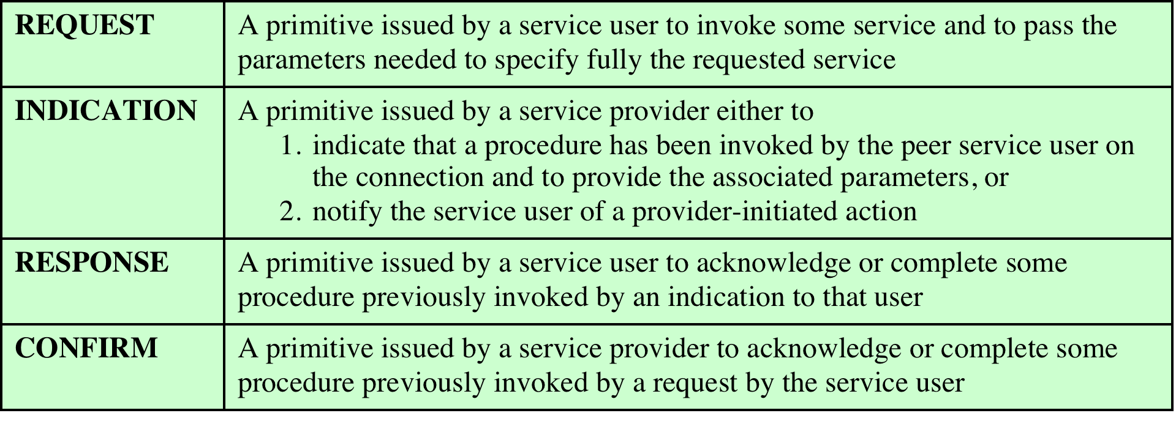
Table 2.1
Service Primitive Types
Notes:
Four types of primitives are used in standards to define the interaction
between adjacent layers in the architecture. These are defined in Table 2.1.

Slide 30
Notes:
The layout of Figure 2.10a suggests the time ordering of these events.
This sequence of events is referred to as a confirmed service , as the initiator
receives confirmation that the requested service has had the desired effect at the
other end. If only request and indication primitives are involved (corresponding to
steps 1 through 3), then the service dialog is a nonconfirmed service ; the initiator
receives no confirmation that the requested action has taken place (Figure 2.10b).

Slide 31
Traditional Internet-Based Applications
Three common applications that have been standardized to operate on top of TCP are:
Simple Mail Transfer Protocol (SMTP)
Provides a mechanism for transferring messages among separate hosts
File Transfer Protocol (FTP)
Used to send files from one system to another under user command
Both text and binary files are accommodated
Secure Shell (SSH)
Provides a secure remote logon capability
Notes:
A number of applications have been standardized to operate on top of TCP. We
mention three of the most common here.
The Simple Mail Transfer Protocol (SMTP) provides a basic electronic mail
transport facility. It provides a mechanism for transferring messages among separate
hosts. Features of SMTP include mailing lists, return receipts, and forwarding.
SMTP does not specify the way in which messages are to be created; some local
editing or native electronic mail facility is required. Once a message is created,
SMTP accepts the message and makes use of TCP to send it to an SMTP module
on another host. The target SMTP module will make use of a local electronic mail
package to store the incoming message in a user’s mailbox.
The File Transfer Protocol (FTP) is used to send files from one system to
another under user command. Both text and binary files are accommodated, and
the protocol provides features for controlling user access. When a user wishes to
engage in file transfer, FTP sets up a TCP connection to the target system for the
exchange of control messages. This connection allows user ID and password to be
transmitted and allows the user to specify the file and file actions desired. Once a
file transfer is approved, a second TCP connection is set up for the data transfer.
The file is transferred over the data connection, without the overhead of any headers
or control information at the application level. When the transfer is complete,
the control connection is used to signal the completion and to accept new file transfer
commands.
SSH (Secure Shell) provides a secure remote logon capability, which enables a
user at a terminal or personal computer to log on to a remote computer and function
as if directly connected to that computer. SSH also supports file transfer between
the local host and a remote server. SSH enables the user and the remote server to
authenticate each other; it also encrypts all traffic in both directions. SSH traffic is
carried on a TCP connection.

Slide 32
Table 2.2 Multimedia Terminology
Notes:
With the increasing availability of broadband access to the Internet has come
an increased interest in Web-based and Internet-based multimedia applications.
The terms multimedia and multimedia applications are used rather loosely in the
Literature and in commercial publications, and no single definition of the term
multimedia has been agreed. For our purposes, the definitions in Table 2.2 provide
a starting point.

Slide 33
Notes:
One way to organize the concepts associated with multimedia is to look at
a taxonomy that captures a number of dimensions of this field. Figure 2.11 looks
at multimedia from the perspective of three different dimensions: type of media,
applications, and the technology required to support the applications.

Slide 34
Media Types
audio generally encompasses sounds that are produced by the human speech mechanism
image supports the communication of individual pictures, charts, or drawings
video service carries sequences of pictures in time
text is information that can be entered via a keyboard and is directly readable and printable
Notes:
Typically, the term multimedia refers to four distinct types of media: text, audio,
graphics, and video.
From a communications perspective, the term text is self-explanatory, referring
to information that can be entered via a keyboard and is directly readable and
printable. Text messaging, instant messaging, and text (non-html) e-mail are common
examples, as are chat rooms and message boards. However, the term often is
used in the broader sense of data that can be stored in files and databases and that
does not fit into the other three categories. For example, an organization’s database
may contain files of numerical data, in which the data are stored in a more compact
form than printable characters.
The term audio generally encompasses two different ranges of sound. Voice,
or speech, refers to sounds that are produced by the human speech mechanism.
Generally, a modest bandwidth (under 4 kHz) is required to transmit voice.
Telephony and related applications (e.g., voice mail, audio teleconferencing, and
telemarketing) are the most common traditional applications of voice communications
technology. A broader frequency spectrum is needed to support music
applications, including the download of music files.
The image service supports the communication of individual pictures, charts,
or drawings. Image-based applications include facsimile, computer-aided design
(CAD), publishing, and medical imaging. Images can be represented in a vector
graphics format, such as is used in drawing programs and PDF files. In a raster
graphics format, an image is represented as a two-dimensional array of spots, called
pixels. The compressed JPG format is derived from a raster graphics format.
The video service carries sequences of pictures in time. In essence, video
makes use of a sequence of raster-scan images.

Slide 35
Table 2.3 Domains of Multimedia Systems and Example Applications
Notes:
The Internet, until recently, has been dominated by information retrieval applications,
e-mail, and file transfer, plus Web interfaces that emphasized text and images.
Increasingly, the Internet is being used for multimedia applications that involve
massive amounts of data for visualization and support of real-time interactivity.
Streaming audio and video are perhaps the best known of such applications. An
example of an interactive application is a virtual training environment involving distributed
simulations and real-time user interaction [VIN98]. Some other examples
are shown in Table 2.3.

Slide 36
Multimedia Applications
Information systems
Communication systems
Information kiosks, electronic books that include audio and video, and multimedia expert systems
Support collaborative work, such as videoconferencing
Entertainment systems
Computer and network games and other forms of audiovisual entertainment
Business systems
Business-oriented multimedia presentations, video brochures, and online shopping
Educational systems
Electronic books with a multimedia component, simulation and modeling applets, and other teaching support systems
Notes:
[GONZ00] lists the following multimedia application domains:
• Information systems: These applications present information using multimedia.
Examples include information kiosks, electronic books that include audio
and video, and multimedia expert systems.
• Communication systems: These applications support collaborative work, such
as videoconferencing.
• Entertainment systems: These applications include computer and network
games and other forms of audiovisual entertainment.
• Business systems: These applications include business-oriented multimedia
presentation, video brochures, and online shopping.
• Educational systems: These applications include electronic books with a multimedia
component, simulation and modeling applets, and other teaching
support systems.
One point worth noting is highlighted in Figure 2.11. Although traditionally
the term multimedia has connoted the simultaneous use of multiple media types
(e.g., video annotation of a text document), it has also come to refer to applications
that require real-time processing or communication of video or audio alone. Thus,
voice over IP (VoIP), streaming audio, and streaming video are considered multimedia
applications even though each involves a single media type.

Slide 37
Multimedia Technologies
Some technologies that are relevant to the support of multimedia applications are:
Compression
JPG for still images
MPG for video
Communications/networking
Refers to the transmission and networking technologies that can support high-volume multimedia traffic
Protocols
RTP
SIP
Quality of service (QoS)
Can deal with priority, delay constraints, delay variability constraints, and other similar requirements
Notes:
Figure 2.11 lists some of the technologies that are relevant to the support of multimedia
applications. As can be seen, a wide range of technologies is involved. The
lowest four items on the list are beyond the scope of this book. The other items
represent only a partial list of communications and networking technologies for
multimedia. These technologies and others are explored throughout the book.
Here, we give a brief comment on each area.
• Compression: Digitized video, and to a much lesser extent audio, can generate
an enormous amount of traffic on a network. A streaming application, which
is delivered to many users, magnifies the traffic. Accordingly, standards have
been developed for producing significant savings through compression. The
most notable standards are JPG for still images and MPG for video.
• Communications/networking: This broad category refers to the transmission
and networking technologies (e.g., SONET, ATM) that can support high-volume
multimedia traffic.
• Protocols: A number of protocols are instrumental in supporting multimedia
traffic. One example is the Real-time Transport Protocol (RTP), which is
designed to support inelastic traffic . RTP uses buffering and discarding strategies
to assure that real-time traffic is received by the end user in a smooth
continuous stream. Another example is the Session Initiation Protocol (SIP),
an application-level control protocol for setting up, modifying, and terminating
real-time sessions between participants over an IP data network.
• Quality of service (QoS): The Internet and its underlying local area and wide
area networks must include a QoS capability to provide differing levels of service
to different types of application traffic. A QoS capability can deal with
priority, delay constraints, delay variability constraints, and other similar
requirements.

Slide 38
Sockets Programming
Concept was developed in the 1980s in the UNIX environment as the Berkeley Sockets Interface
De facto standard application programming interface (API)
Basis for Window Sockets (WinSock)
Enables communication between a client and server process
May be connection oriented or connectionless
Notes:
The concept of sockets and sockets programming was developed in the 1980s in the
UNIX environment as the Berkeley Sockets Interface. In essence, a socket enables
communication between a client and server process and may be either connection
oriented or connectionless. A socket can be considered an end point in a communication.
A client socket in one computer uses an address to call a server socket on
another computer. Once the appropriate sockets are engaged, the two computers
can exchange data.
Typically, computers with server sockets keep a TCP or UDP port open,
ready for unscheduled incoming calls. The client typically determines the socket
identification of the desired server by finding it in a Domain Name System (DNS)
database. Once a connection is made, the server switches the dialogue to a different
port number to free up the main port number for additional incoming calls.
Internet applications, such as TELNET and remote login (rlogin), make use
of sockets, with the details hidden from the user. However, sockets can be constructed
from within a program (in a language such as C, Java, or Python), enabling
the programmer to easily support networking functions and applications. The
sockets programming mechanism includes sufficient semantics to permit unrelated
processes on different hosts to communicate.
The Berkeley Sockets Interface is the de facto standard application programming
interface (API) for developing networking applications, spanning a wide range
of operating systems. Windows Sockets (WinSock) is based on the Berkeley specification.
The Sockets API provides generic access to interprocess communications
Services. Thus, the sockets capability is ideally suited for students to learn the principles
of protocols and distributed applications by hands-on program development.

Slide 39
The Socket
Formed by the concatenation of a port value and an IP address
Unique throughout the Internet
Used to define an API
Generic communication interface for writing programs that use TCP or UDP
Stream sockets
All blocks of data sent between a pair of sockets are guaranteed for delivery and arrive in the order that they were sent
Datagram sockets
Delivery is not guaranteed, nor is order necessarily preserved
Raw sockets
Allow direct access to lower-layer protocols
Notes:
Recall that each TCP and UDP header includes Source Port and Destination Port
fields (Figure 2.6). These port values identify the respective users (applications) of
the two TCP or UDP entities. Also, each IPv4 and IPv6 header includes Source
Address and Destination Address fields (Figure 2.7); these IP addresses identify
the respective host systems. The concatenation of a port value and an IP address
forms a socket , which is unique throughout the Internet. Thus, in Figure 2.4, the
combination of the IP address for host B and the port number for application X
uniquely identifies the socket location of application X in host B. As the figure
indicates, an application may have multiple socket addresses, one for each port into
the application.
The socket is used to define an API, which is a generic communication interface
for writing programs that use TCP or UDP. In practice, when used as an API,
a socket is identified by the triple (protocol, local address, local process). The local
address is an IP address and the local process is a port number. Because port numbers
are unique within a system, the port number implies the protocol (TCP or
UDP). However, for clarity and ease of implementation, sockets used for an API
include the protocol as well as the IP address and port number in defining a unique
socket.
Corresponding to the two protocols, the Sockets API recognizes two types of
sockets: stream sockets and datagram sockets. Stream sockets make use of TCP,
which provides a connection-oriented reliable data transfer. Therefore, with stream
sockets, all blocks of data sent between a pair of sockets are guaranteed for delivery
and arrive in the order that they were sent. Datagram sockets make use of UDP,
which does not provide the connection-oriented features of TCP. Therefore, with
datagram sockets, delivery is not guaranteed, nor is order necessarily preserved.
There is a third type of socket provided by the Sockets API: raw sockets. Raw
sockets allow direct access to lower-layer protocols, such as IP.

Slide 40
Table 2.4 Core Socket Functions (Table can be found on page 78 in textbook)
Notes:
This subsection summarizes the key system calls. Table 2.4 lists the core Socket
functions.
The first step in using Sockets is to create a new socket using the
socket() command. This command includes three parameters. The domain
parameter refers to the area where the communicating processes exist.
Type specifies whether this is a stream or datagram socket, and protocol
specifies either TCP or UDP. The reason that both type and protocol need to be
specified is to allow additional transport-level protocols to be included in a future
implementation. Thus, there might be more than one datagram-style transport protocol
or more than one connection-oriented transport protocol. The socket()
command returns an integer result that identifies this socket; it is similar to a UNIX
file descriptor. The exact socket data structure depends on the implementation. It
includes the source port and IP address and, if a connection is open or pending, the
destination port and IP address and various options and parameters associated with
the connection.
After a socket is created, it must have an address to listen to. The bind()
function binds a socket to a socket address.

Slide 41
Notes:
Figure 2.12 shows the interaction of the clients and server sides in setting up,
using, and terminating a connection.

Slide 42
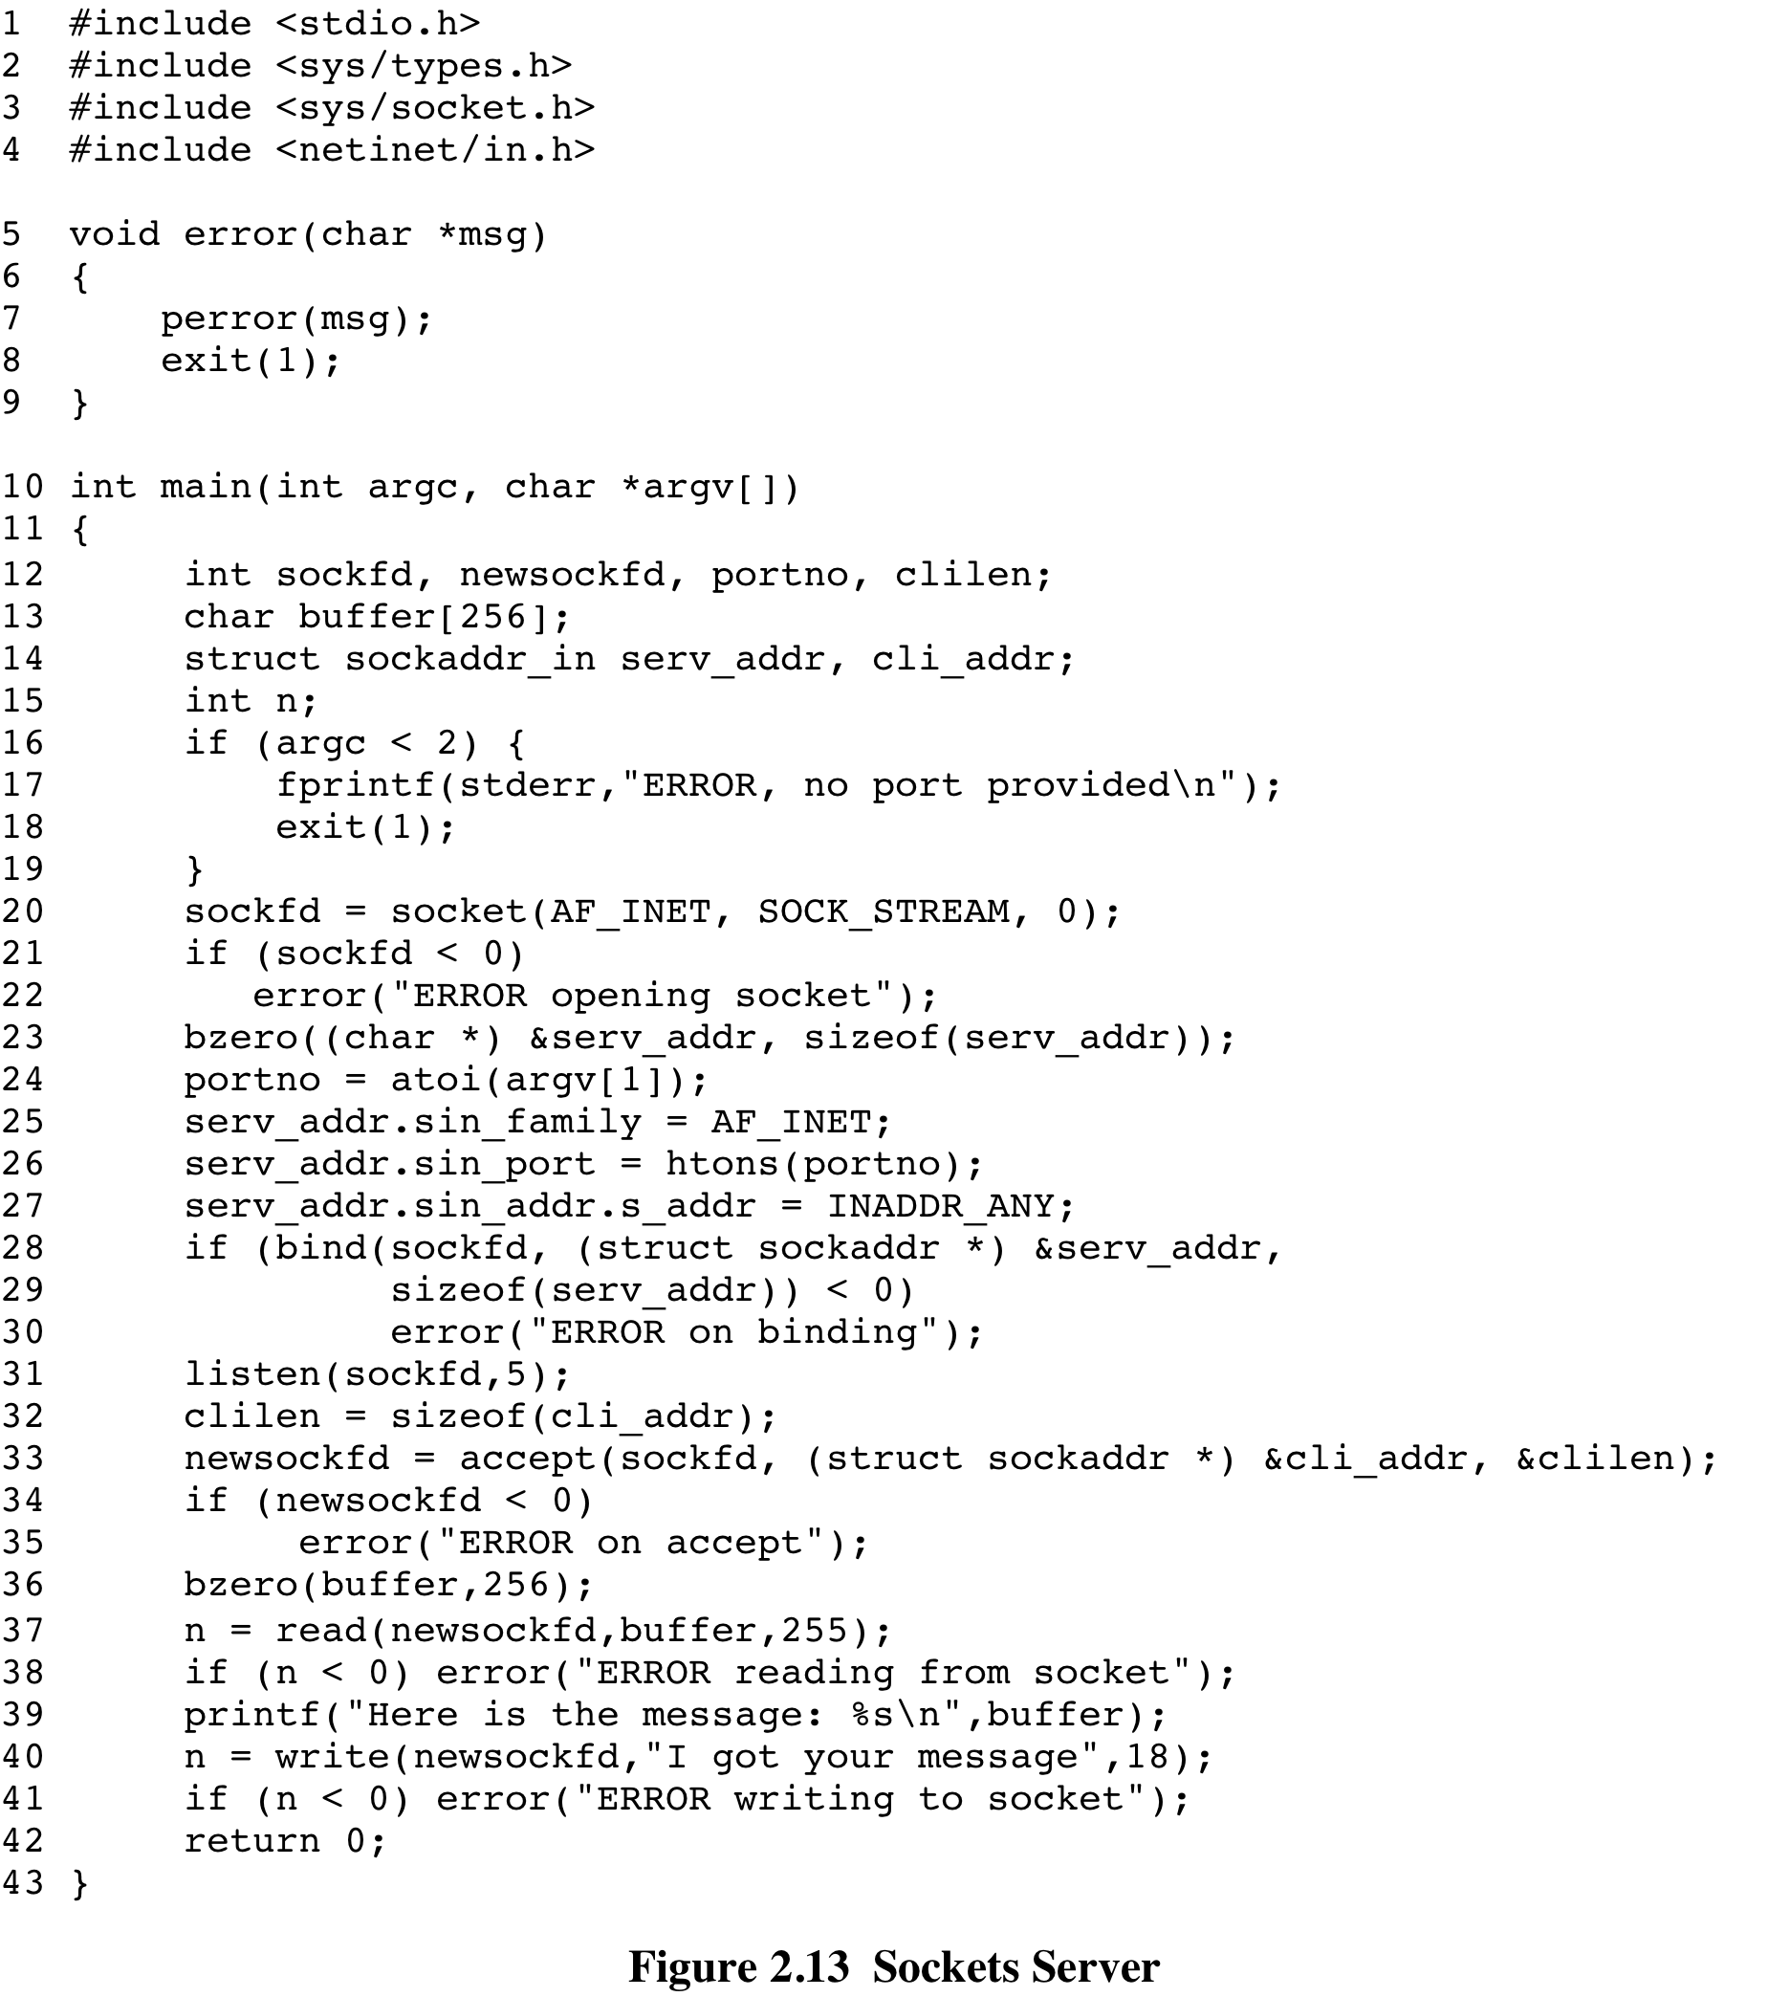
(Figure 2.13 can be found on page 81 in textbook)
Notes:
Now that you see what the two programs do, we can examine the
code, starting with the server (Figure 2.13).

Slide 43
(Figure 2.14 can be found on page 82 in textbook)
Notes:
The client program is shown in Figure 2.14.

Slide 44
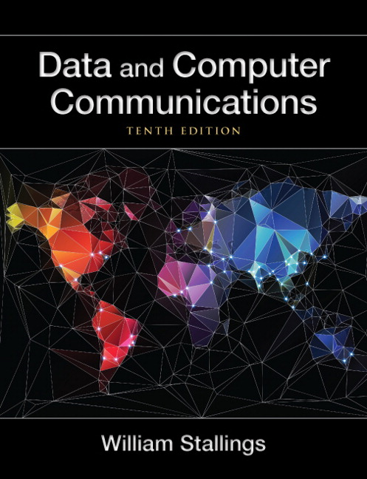
Summary
The need for a protocol architecture
Simple protocol architecture
TCP/IP protocol architecture
TCP/IP layers
Operation of TCP and IP
TCP and UDP
IP and IPv6
Protocol interfaces
Standardization within a protocol architecture
Standards and protocol layers
Service primitives and parameters
Traditional internet-based applications
Multimedia
Media types
Multimedia applications
Multimedia technologies
Sockets programming
The socket
Sockets interface calls
Notes:
Chapter 2 summary.

